Slide 1
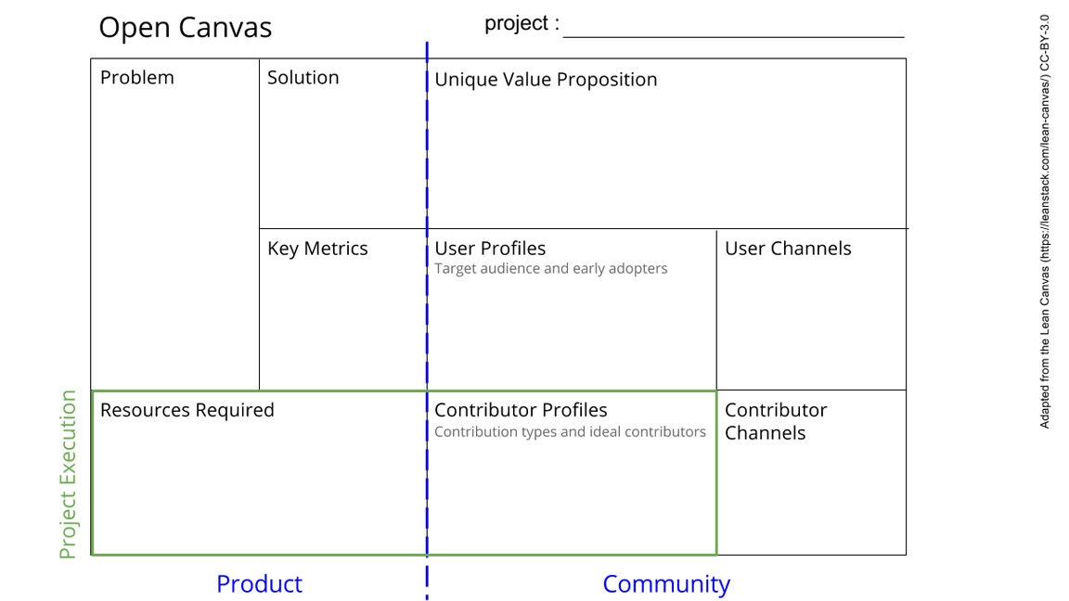
Mycelium
Data Industry
Non-consent
Attention economy
Exploitative
advertising
Sharing Economy
Extractive
Inefficient
Apps all in different places. No single point for info/resources.
No easy way for communities to create alternatives together
A new social network for everyone, by everyone, that allows people to collaborate, build solutions to local & global problems, keeps money in local economies and creates an interoperable network of tech/apps in one.
Get stuff done together that works better for everyone
Use, create and share technology that helps everyone
Build a future you want to be part of
Mycelium: by everyone, for everyone.
Commons-owned network (ecological system)
Are people able to access it?
Is everyone safe using it?
Is it safe from co-option /aggressors?
Are communities using it to build solutions?
Self financing.
Meeting People
Word of mouth
FB groups
Networking through community & other orgs
Content providers
Future online presence
Grassroots networks
Independent media
Academic channels
People who are unhappy with current social media & apps
People interested in creating a more equal world
Community groups
Content providers who are unhappy with current channels
People wanting to trade locally/ethically
People
Skills
Spaces/venues to meet
A platform to organise on.
(support/funding)
Infrastructure
As above; all people can build onto the network in different ways.
Coding groups
Students
Research groups
Speaking at relevant events
See next slide for instructions!
Notes:
Go to File > Make a Copy… to make your own canvas
See next slide for instructions

Slide 2
